Slide 1
Introducing the
MUSCULOSKELETAL system

Slide 2
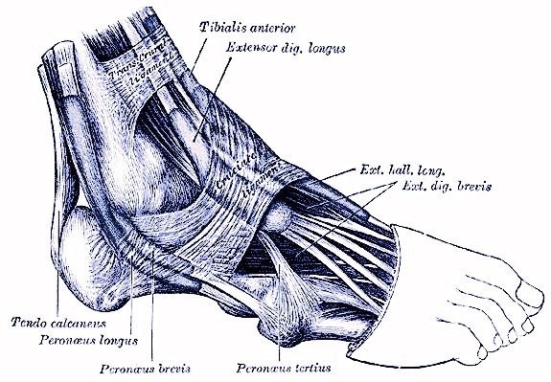
Teachers in Residence Programme
Andrew Fogarty and Clive Monahan
Notes:
Repairing tendons
Image – Grey’s anatomy

Slide 3
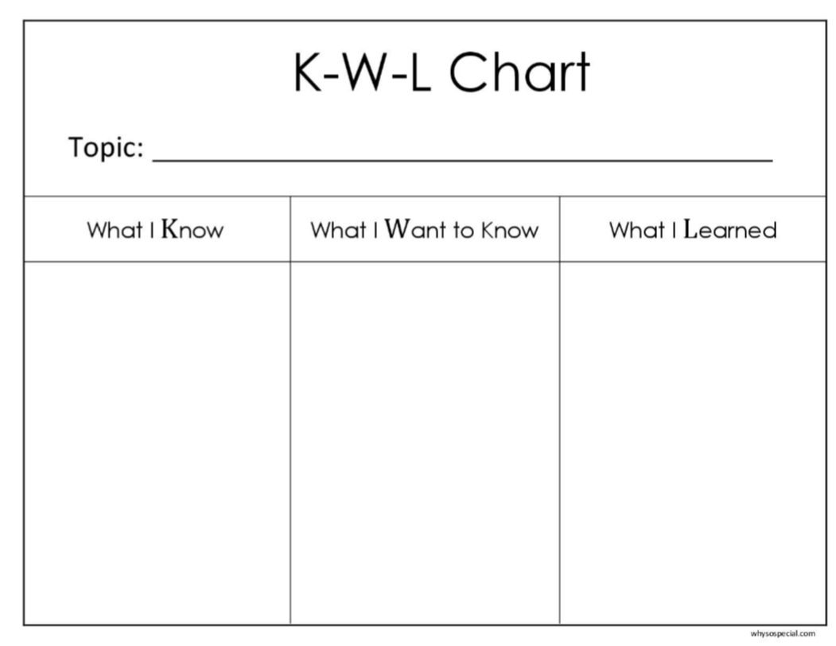
Class discussion around the Musculoskeletal System
Why do you require a skeleton?
What is it made from?
Is it living tissue?
Can you name bones?
How does the skeleton allow for movement?
Explain the functions of muscles?
What are tendons?
What can go wrong with the musculoskeletal system?
Notes:
Class discussion around musculoskeletal system
Why do you require a skeleton?
What is it made from?
Is it livng tissue?
Can you name bones?
How does the skeleton allow for movement?
Explain the functions of muscles?
What are tendons and ligaments?
What can go wrong with the musculoskeletal system?

Slide 4
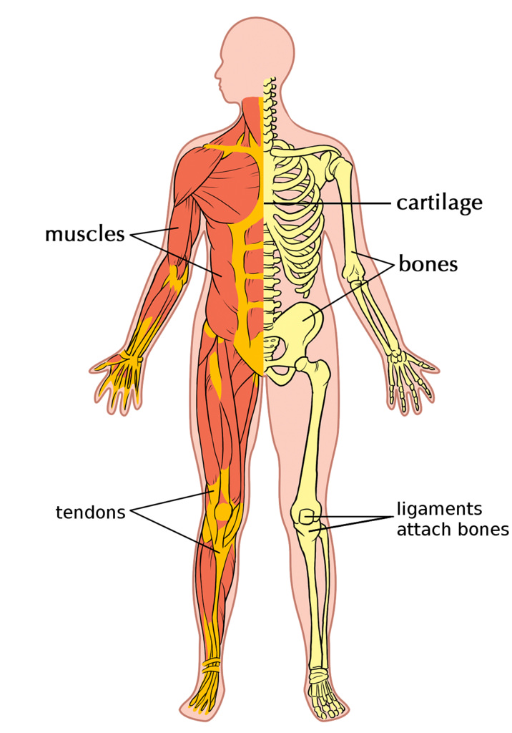
Musculoskeletal System
Cartilage
Muscles
Muscles
Bones
Tendons
Joints and Ligaments
Notes:
Image: https://www.flickr.com/photos/121935927@N06/13578837903

Slide 5
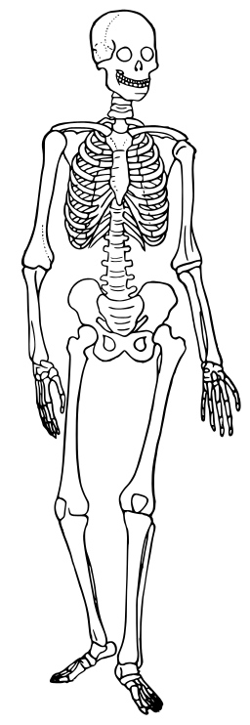
Bones-Human Skeleton
Skull
Clavicle
Scapula (shoulder blade)
Rib cage
Humerus
Spine
Ulna
Radius
Pelvis
Patella
Femur
Tibia
Fibula
Notes:
By Human_skeleton_diagram.png: (Source: Collier's New Encyclopedia, VIII (New York: P.F. Collier & Son Company, 1921), p. 446. derivative work: GregorDS (talk) 09:18, 21 December 2011 (UTC) (Human_skeleton_diagram.png) [Public domain or Public domain], via Wikimedia Commons
Why do you require a skeleton?
Can you name bones?
Could you move if you looked like this? Why/why not?
How does the skeleton allow for movement?

Slide 6
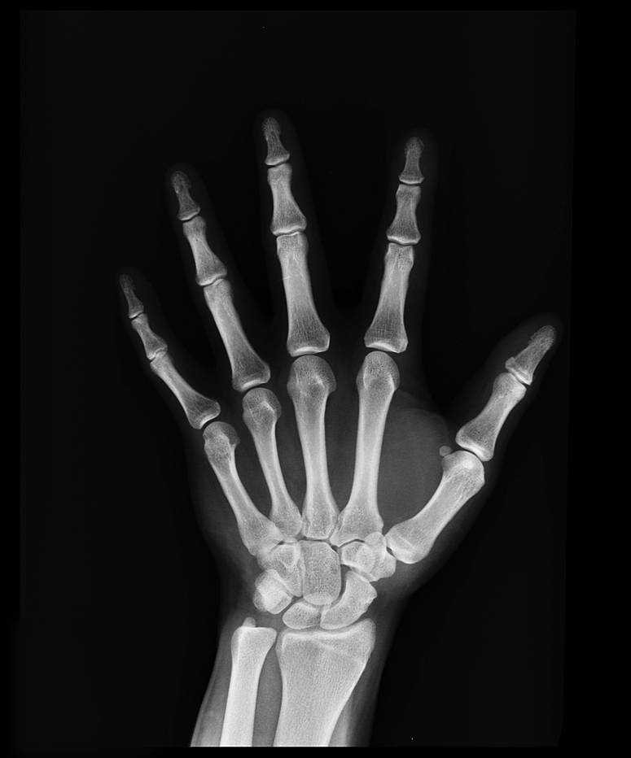
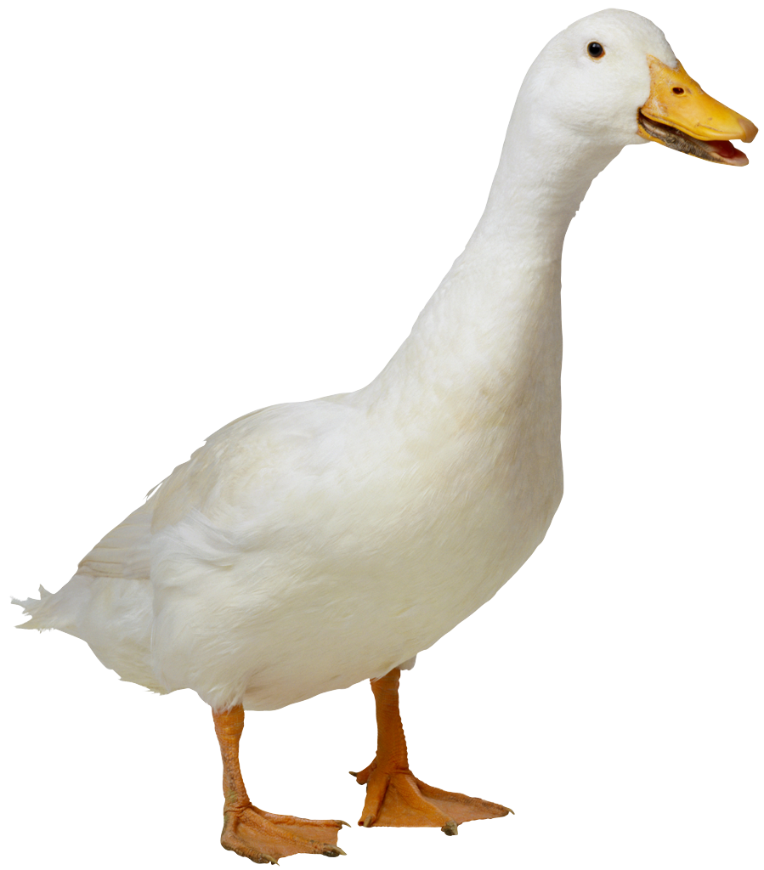
How many bones do you have?
You have:
300 bones at birth
206 bones by adulthood
Where do they go?

Slide 7
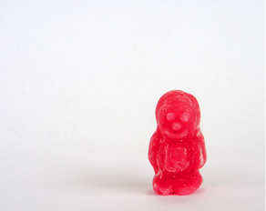
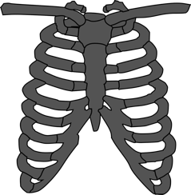
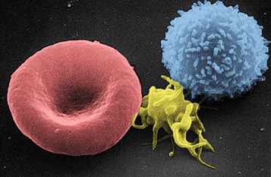
Give structure & support
Movement
Protect vital organs
Make blood cells
Bones-Functions

Slide 8
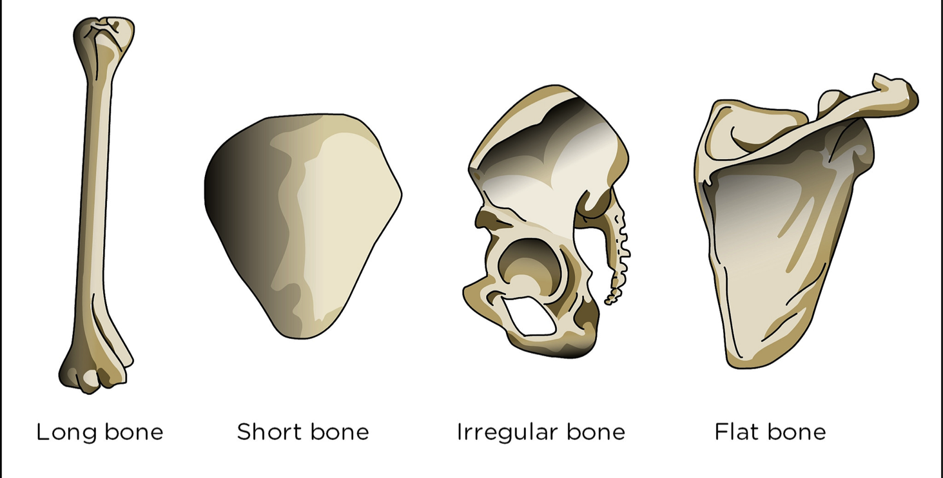
Bones-Types
Can you give examples?
Notes:
Image: https://www.flickr.com/photos/121935927@N06/13578836693
Long bones=femur (the longest bone in the body), tibia, fibula, metatarsals, phalanges, humerus, radius, ulna, and metacarpals. Long bones function to support the weight of the body and facilitate movement.
Short bones=the carpals in the wrist and the tarsals in the ankles. They provide stability and some movement.
Irregular bones=the vertebrae, sacrum, and coccyx. Irregular bones vary in shape and structure and therefore do not fit into any other category. They often have a fairly complex shape, which helps protect internal organs.
Flat bones=sternum, scapula, ribs. The function of flat bones is to protect internal organs such as the brain, heart, and pelvic organs.

Slide 9
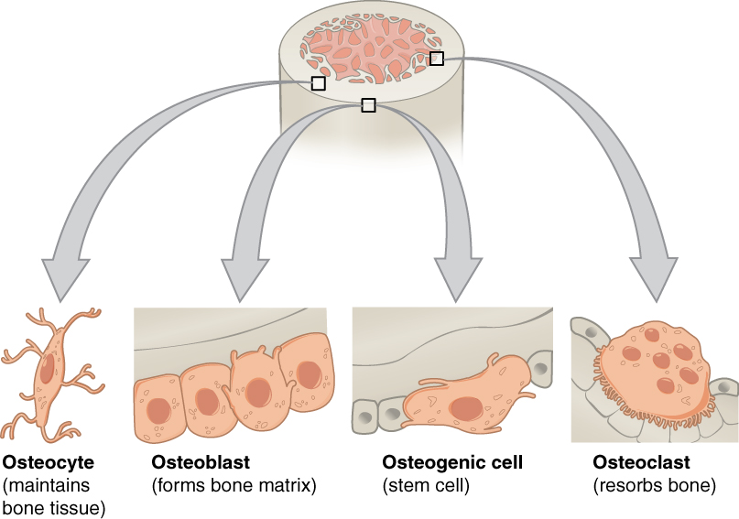
Bone Cells
Notes:
Image: https://upload.wikimedia.org/wikipedia/commons/b/b6/604_Bone_cells.jpg
There is a continual balance between oseoblasts generating new bone and osteoclasts breaking down bone.
Osteogenic cells=They are the only bone cells that divide. Osteogenic cells develop into osteoblasts.
Osteoblasts=They are responsible for forming new bones. Osteoblasts make and secrete a collagen matrix and calcium salts.
Osteocytes=They are the most common and mature type of bone cell. When osteoblasts become trapped in the matrix they have secreted, they transform into osteocytes.
Osteoclasts=They are the cells that break down and reabsorb bone. Osteoclasts do not come from osteogenic cells, but from monocytes (white blood cells) and macrophages.

Slide 10
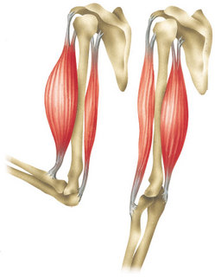
Bones are unable to move by themselves
Muscles move bones by shortening, i.e. contracting
Muscles can only “pull” and do not “push” bones
Muscles tend to occur in pairs, i.e. work in opposition
Muscles
Flexion
biceps
triceps
Extension

Slide 11
Muscles-Antagonistic Pairs
As you bend your elbow and raise your forearm which muscle is contracting?
As you straighten your elbow and lower your forearm which muscle is contracting?
Triceps (Agonist)
Biceps (Agonist)
What are the antagonist muscles and what are they doing?
Notes:
Antagonistic pairs-pairs of muscles that work together (agonist and antagonist) to start or stop movement.
As the agonist muscle contracts, the antagonist muscle opposes its force of movement.
Ex. As the biceps (agonist) contract the triceps (antagonist) relax. As the triceps (agonist) contract the biceps (antagonist) relax.

Slide 12
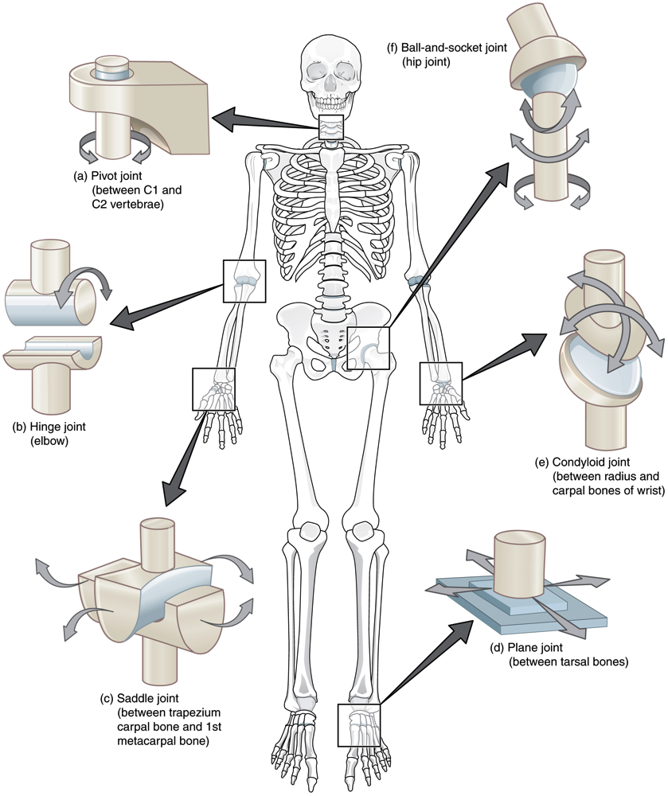
Joints
Connect bones to bones
Six types:
Pivot
Hinge
Saddle
Plane
Condyloid
Ball-and-Socket
Notes:
Image: https://upload.wikimedia.org/wikipedia/commons/thumb/e/ed/909_Types_of_Synovial_Joints.jpg/800px-909_Types_of_Synovial_Joints.jpg

Slide 13
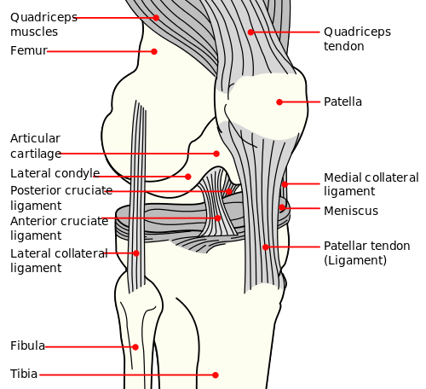
Joints-Cartilage and Ligaments
Notes:
Image: https://upload.wikimedia.org/wikipedia/commons/thumb/0/09/Knee_diagram.svg/500px-Knee_diagram.svg.png

Slide 14
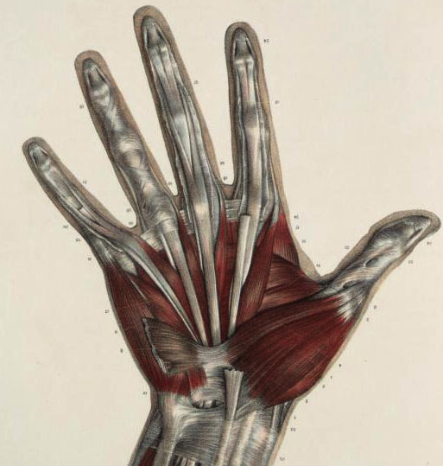
Tendons-Connect Bones to Muscles

Slide 15
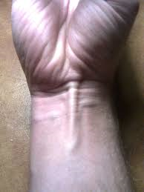
Do you have this tendon in your wrist?
Most people have it
14% of people do not have it
Was used by humans years ago to flex the wrist
Not needed anymore and can be removed
Can be used to replace damaged tendons
Palmaris Longus

Slide 16
Damage to MS System
What | Damage | Medical Treatment
Bones | Simple fracture Compound fracture | Cast Plates Pins
Muscles | Strain Tears | RICE Brace
Cartilage | Break down Tears Loose pieces | Assess damage with arthroscope Clean with saline solution
Ligaments | Sprain Tears | Brace Surgery
Tendons | Tears “Snapped” | RICE Splint Brace

Slide 17
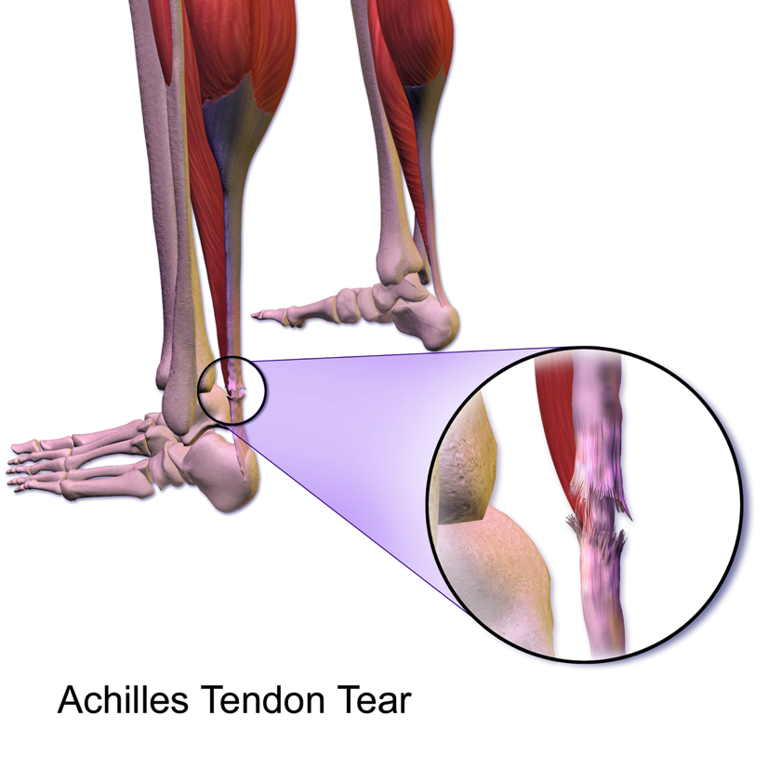
You will be a Biomedical Engineer to repair a damaged tendon!
Achilles Tendon Tear
Notes:
Image: https://upload.wikimedia.org/wikipedia/commons/7/7f/Achilles_Tendon_Tear.png
Most common tendon injuries in athletes is damage to the Achilles Tendon that connects the heel to the muscle in the lower leg.

Slide 18
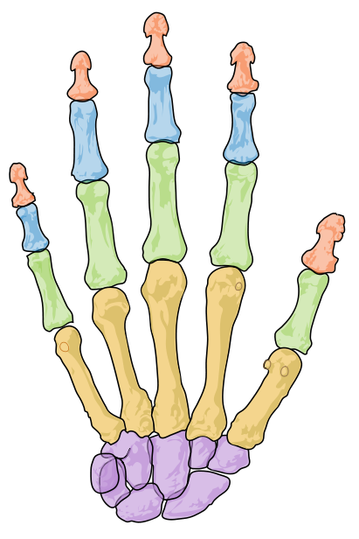
Step 1-
Make a hand
Straws (Bones)
String (Tendons)
Each finger gets 3 straws that act as bones
Each finger gets 1 string that acts as the tendons
Make sure you leave a big space between the straws!

Slide 19
Step 1-
Make a hand
Tape the string to the
tip of the finger here
Tape the 3 straws to the paper
Do not tape the string!
Bend the paper between the straws for the fingers to move easier

Slide 20
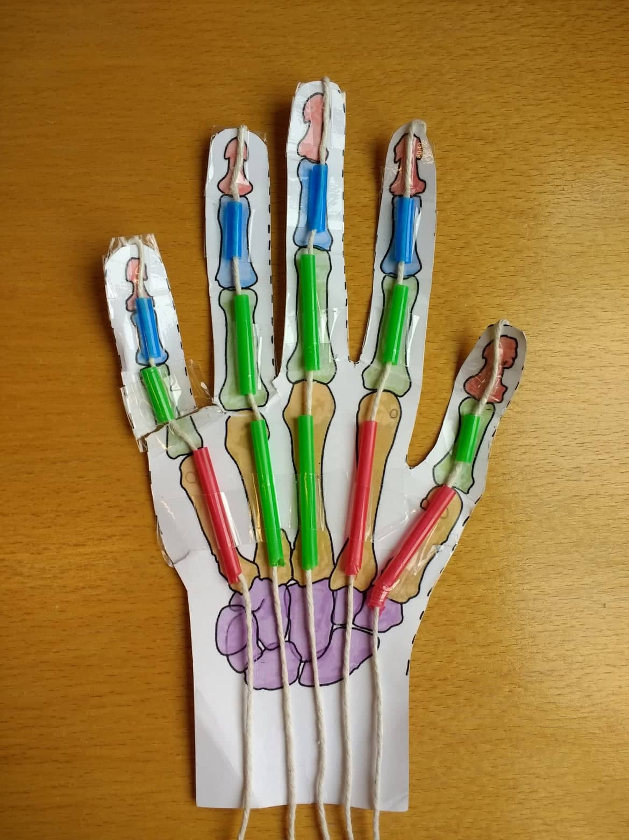

Slide 21
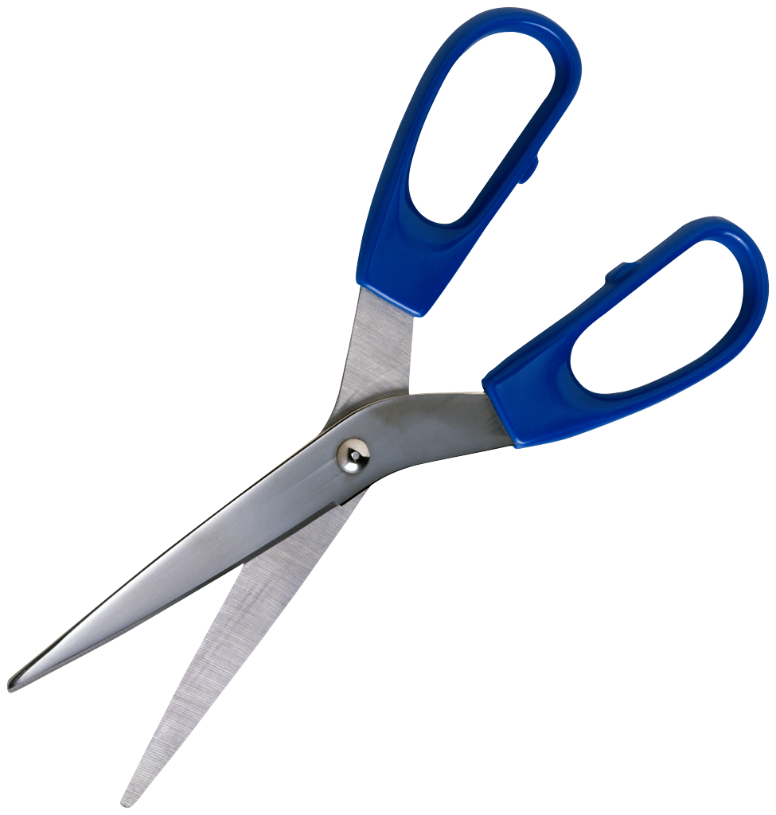
Step 2-
Damage and repair tendon
Use your scissors to cut the string between two straws
Repair your “tendon” using the biomaterials available in your Biomedical Engineering Kit

Slide 22
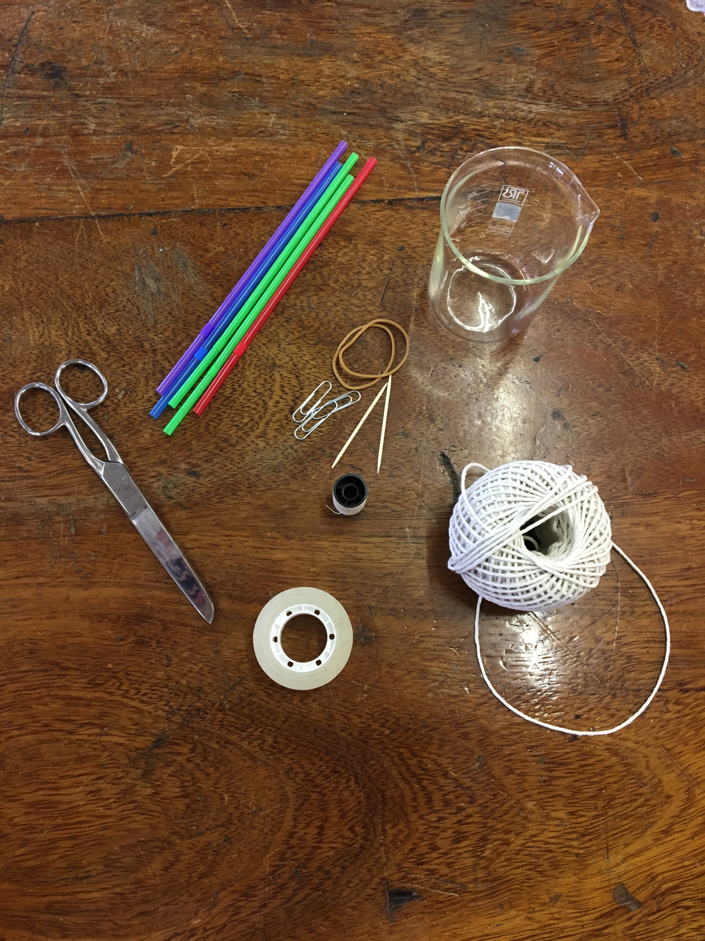
Paper hand cut-out
Straws
String
Paperclips
Rubber bands
Toothpicks
Thread
Scissors
Tape

Slide 23
EVALUATION
1.) Do you think your medical device is successful? Why or why not?
2.) If you were building the medical device again, what would you do differently?
3.) Answer the questions on the worksheet.

Slide 24
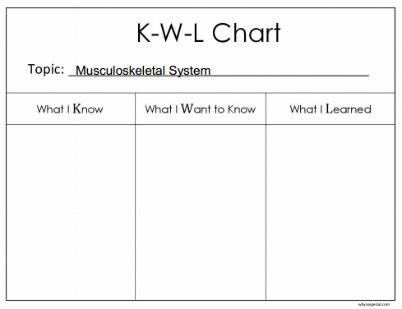

Slide 25
References:
commons.wikimedia.org
www.flickr.com
Gray’s Anatomy
Acknowledgements:
Sincere thanks to all of the researchers who gave lectures and generously gave their time throughout the course.
Thanks also to all the participating teachers who very kindly shared ideas and resources.

Slide 26
This publication has emanated from research conducted with the financial support of Science Foundation Ireland (SFI) and is co-funded under the European Regional Development Fund under Grant Number 13/RC/2073.
This project has been funded by the European Union Seventh Framework Programme under Marie Curie Initial Training Networks (FP7-PEOPLE-2012-ITN) and Grant Agreement Number 317304 (AngioMatTrain). This project has also been funded by the European Union Horizon 2020 Programme (H2020-MSCA-ITN-2015) under the Marie Skłodowska-Curie Innovative Training Networks and Grant Agreement Numbers 676408 (BrainMatTrain) and 676338 (Tendon Therapy Train).

